Slide 1
Lab3 OS
File systems. System calls and library functions for working with files and directories

Slide 2
Working with files
Modern operating systems provide programmers with several functions and services with which they can develop programs for that operating system.
These functions, called system calls, allow low-level access to your computer's hardware and software resources, and are part of the operating system's Application Programming Interface (API).
Library functions are those implemented in libraries specific to programming languages, representing collections of functions at a higher level of abstraction than system calls.
System calls provided by the operating system are used to implement library functions.

Slide 3
Title and Content Layout with Chart
We will continue to focus on the system functions that UNIX operating systems provide for working with files and directories. All function prototypes, along with the related programs that use them, are written in C language.
The system calls that we will present below are also found in the MS-DOS operating systems.
Each file can be accessed in user programs based on a unique identifier called a handle. This handle is a file descriptor, an integer that is associated with the file when it is opened.

Slide 4
Open, close and other functions
To open a file for reading, writing or editing, we use the open function:
The function returns -1 in case of error. Otherwise, it returns the file descriptor associated with the open file.
pathname - represents the file name.
flags and mode are on the next slide.

Slide 5
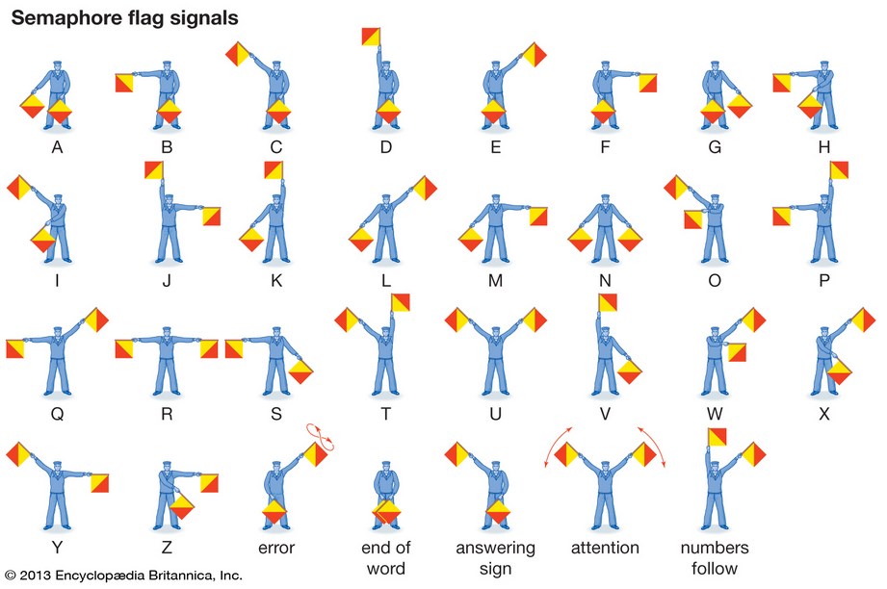
Parameters
Flags - represent a series of flags for opening the file. These flags are implemented as a string of bits, in which each bit or group of bits has a certain meaning. For each meaning you find the definition of the bit or group of bits in fnctl.h, in the form of constants that you can combine using logical operators per bit (mainly the logical operator or). Some of the constants are:
O_RDONLY - read only
O_WRONLY - open for writing only
O_RDWR - open for reading and writing
O_APPEND - open for addition at the end of the file
O_CREAT - creating the file, if it does not already exist; if used with this option, the open function must also receive the mode parameter.
O_EXCL - "exclusive" file creation: if O_CREAT was used and the file already exists, the open function will return error
O_TRUNC - if the file exists, its contents are deleted

Slide 6
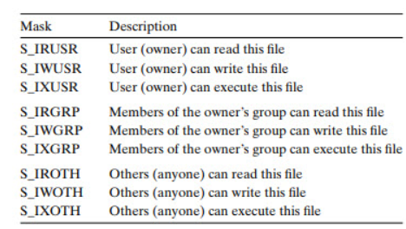
Parameters
mode - is used only if the file is created and specifies the access rights associated with the file. These are obtained by combining constants using its operator ('|'), as in the previous option. The constants can be:
S_IRUSR - read right for file owner
S_IWUSR - write right for file owner
S_IXUSR - runtime right for file owner
S_IRGRP - read right for the group that owns the file
S_IWGRP - write right for the group that owns the file
S_IXGRP - execution right for the group that owns the file
S_IROTH - read right for other users
S_IWOTH - write right for other users
S_IROTH - execution right for other users

Slide 7
Function create and close
This function can also be used to create files:
equivalent to specifying O_WRONLY options O_CREAT | O_TRUNC the open function.
After using the file, it must be closed using the function
where fd is the file descriptor obtained at open.

Slide 8
Read function
Reading data from an open file is done with the function:
The function reads several exactly count bytes from the current position in the file whose descriptor is fd and places them in the memory area indicated by the buf pointer.
It is possible that less than count bytes can be read in the file at a time (for example, if the end of the file has been reached), so the read function will buffer only as many bytes as it can read. In any case, the function returns the number of bytes read from the file, so this can be easily noticed.
If the end of the file is reached exactly, the function returns zero, and in case of error, -1.

Slide 9
Write function
Data writing is done with:
The function writes to the file the first nbytes bytes of the buffer indicated by the buff. Returns -1 in case of error.
The parameters are like those specified in the signature of the read functions.

Slide 10
Function lseek
Writing and reading operations to and from the file are done at a certain position in the file, considered the current position.
Each read operation, for example, will update the current position indicator by incrementing it by the number of bytes read. The current position indicator can also be set explicitly, using the lseek function:
The function positions the indicator at the offset shift in the file as it can be seen in the following slide.

Slide 11
Function lseek parameters
if the parameter pos has the value SEEK_SET, the positioning is done relative to the beginning of the file.
if the parameter pos has the value SEEK_CUR, the positioning is done relative to the current position.
if the parameter pos has the value SEEK_END, the positioning is relative to the end of the file
The offset parameter can also take negative values ​​and represents the displacement, calculated in bytes.
In case of error, the function returns -1.

Slide 12
Other functions
Make directory
Remove directory
Note: When using a system function, it is very important to test the value returned by it. If the function call ended in error, the program must recognize this case and act accordingly, for example by printing an error message and possibly ending the execution.

Slide 13
Library functions
In the standard C library there are several functions for managing files. They use a descriptor represented by a data structure, FILE, to identify files.
Opening a file:
The function opens the file indicated by pathname, creates a FILE structure containing information about the file and returns a pointer to it. This pointer will be the element that can still be used to access the file. The mode parameter is a string that indicates how to open the file. "r" means read opening; "w" means write opening. The file type can also be specified: "t" for text file, "b" for binary file. The options can be combined, for example in the form "r + t".
Closing the file is done with close where stream is the pointer to the FILE structure obtained when opening the file.

Slide 14
File operations
formatting file writing; the string that specifies the format is similar to the one in the printf statement.
read from file, like the scanf function.

Slide 15
File operations
Reads from the file indicated by the stream several nmemb elements, each of size size, and puts them in the memory area indicated by ptr.
Write in the file indicated by the stream several nmemb elements, each of size size, which it takes from the memory area indicated by ptr.
Refer to the man pages corresponding to the system calls and library functions discussed, as well as their related functions. System calls are handled in section 2 of the Unix manual, and library functions in section 3, click on the html.
https://man7.org/linux/man-pages/man2/ https://man7.org/linux/man-pages/man3/

Slide 16
Working with directories
The access to the information stored in the directories is made with the help of special functions, with the help of which the names of the contained files can be found and information about them (size, date of creation, related rights, etc.).
If in terms of file management common aspects could be encountered in the cases of DOS and UNIX operating systems, the way in which the directories are exploited (from the programmer's perspective) differs substantially.
Managing directories in MS-DOS (Windows)
Findfirst and findnext functions
These functions use as an intermediary a data structure called struct ffblk, which contains information about a specific file:

Slide 17
Findfirst, findnext functions and ffblk
These functions use as an intermediary a data structure called struct ffblk, which contains information about a specific file:
struct ffblk {
char ff_reserved[21];
char ff_attrib; /*file attributes*/
int ff_ftime; /*time of creation*/
int ff_fdate; /*date of creation*/
long ff_fsize; /*size of file, in bytes*/
char ff_fname[13]; /*name of file and extension (and a dot)*/}

Slide 18
Findfirst, findnext functions and ffblk
Finds the first file that matches the pattern given in the pathname (pattern that can contain the characters * and?) And initializes the data structures used internally by the file search functions.
The function will complete an ffblk structure with information about the first file found. The address of this structure must be given by the user in the ffblk parameter.
The attrib parameter specifies the search attributes. (For more details, see the C-compiler help for MS-DOS).

Slide 19
Findfirst, findnext functions and ffblk
The first file that corresponds to a certain pattern can be found with findfirst.
The following files that correspond to the same pattern can be found by successively calling the findnext function.
This receives as a parameter the ffblk structure used in findfirst, will find the searched file and will complete the ffblk structure with the information specific to the found file.

Slide 20
Managing directories in UNIX
Find out the attributes of the files:
The stat function receives a file name (pathname) as a parameter and writes a stat structure to the buffer address of statbuf, which contains information about that file.
The stat structure can be seen on the next slide.

Slide 22
The pointer indicating the memory area in which the stat function will return this information must be given as the second parameter of the function.
The memory area must be reserved (through malloc) in order to store the state structure.
The fstat function has the same effect, except that it receives a file descriptor as an argument, not its name, so it can only be applied to previously opened files.
The lstat function is like stat, with the difference that if it is applied to a symbolic link, the returned information will refer to the link, not to the indicated file.

Slide 23
Library functions for reading directories
Directories are essentially files with a special format.
The UNIX operating system provides the programmer with a set of system calls that provide the ability to read the contents of directories, thus accessing information about the files and directories contained.
Using these system calls, the standard C library defines a set of functions that conform to the POSIX standard and offer the same features.
It is advisable to use, instead of calling the system functions directly, the library functions, only the latter will be presented in the next slide.

Slide 24
The opendir() function opens a directory stream corresponding to the directory name and returns a pointer to the directory stream. The stream is positioned at the first entry in the directory.
The readdir() function returns a pointer to a dirent structure representing the next directory entry in the directory stream pointed to by dirp. It returns NULL on reaching the end of the directory stream or if an error occurred.

Slide 25
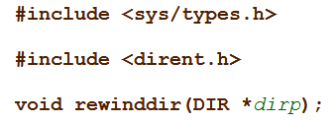
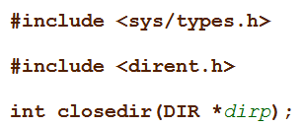
The rewinddir() function resets the position of the directory stream dirp to the beginning of the directory.
The closedir() function closes the directory stream associated with dirp. A successful call to closedir() also closes the underlying file descriptor associated with dirp. The directory stream descriptor dirp is not available after this call.

Slide 26
According to POSIX specifications, the dirent structure contains several fields:
Char d_name[256] with 256 characters excluding termination character (NULL).
Using other existing fields in this structure damages the portability of the program. The d_name field contains the name of a directory entry (filename, directory, etc.).
The DIR structure is a structure used internally by the four functions. The structure will be returned (initialized) by the opendir and must be transmitted as a parameter to the other functions.

Slide 27
The inspection of the files in a directory is done as follows:
the desired directory is "opened" with the opendir function.
read, one by one, an entry in the directory, successively calling the readdir function. Each call of this function will return a pointer to a dirent structure, in which information about the read directory entry will be found. The entries in the directory will be scrolled, one after the other, until the last entry is reached. When there are no more entries in the read directory, the readdir function will return NULL. Also, in case of error, the function will also return NULL, but then it will also position the value of errno accordingly.
in the end. the directory is closed using closedir.

Slide 28
As shown on the previous slides, the only information that can be extracted (according to POSIX) from the dirent structure is the name of the directory entry. All other information about the read entry can be found by calling the functions stat, fstat or lstat.
Refer to the manual pages corresponding to these functions.

Slide 29
Appendix Other functions for working with directories and files
creates fixed links to files
creates symbolic links to files or directories
delete an entry in the directory (link, file or directory)

Slide 30
renaming / moving files
deleting directories
change of current director

Slide 31
determination of the current director
Refer to the man pages corresponding to the functions presented in the last few slides, as well as those of related functions.

Slide 32
Homework
Write a C program for Unix, callable from the command line as follows:
copytree path1 path2
which copies the path1 directory, with all its subdirectories to the path2 directory. If path2 already exists, an error message will be generated. If symbolic links are found in the source, symbolic links will be created at the destination that refer to the same file as the original (the indicated file is not copied!).

